Slide 1






Supervisor : T. Shatha Alkhaldi
Group: 17
Names:
Sara Alrahma
Haya Bin Samih
Hessa Almaarik

Slide 2

Table Of Contents
Introduction
Problem Definition
Aims & Objectives
Background
Related Work
Elicitation Techniques
System Analysis & Design
Implementation
Testing
Conclusion & Future Work
01
02
03
04
05
06
07
08
09
10
2

Slide 3
Introduction
Powerlifting depends on essential gear like belts and wraps for safety and performance. Many athletes struggle to manage their equipment, often forgetting items during training or competition.
The ProGear Smart Bag offers a smart solution using IoT weight sensors and Bluetooth to track gear and notify users via a mobile app. This project aims to reduce human error and help powerlifters stay prepared at all times.
3

Slide 4

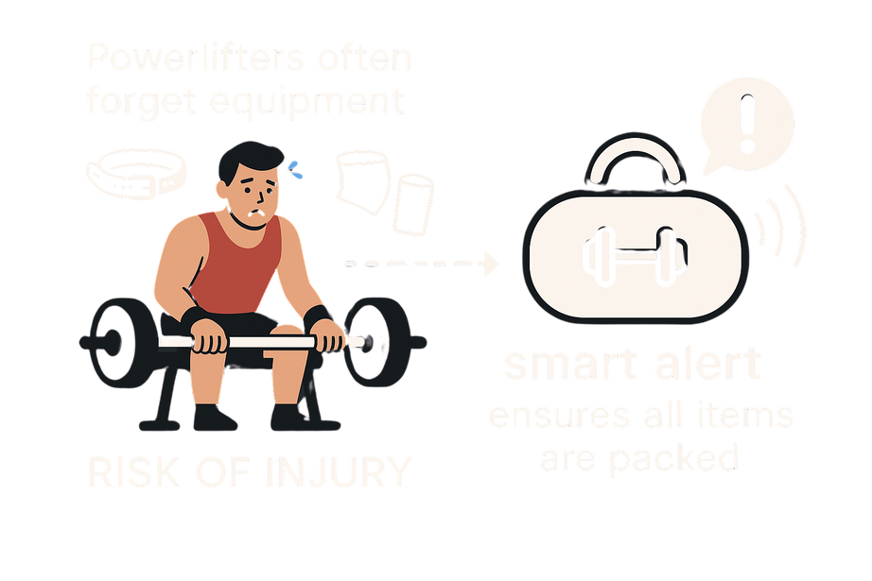
Problem Definition
Powerlifters often forget essential gear like belts or wraps due to stress or busy schedules. Relying on memory or checklists isn’t reliable, and forgetting items can lead to injuries or poor performance.
Traditional bags don’t help verify packed items.
The ProGear Smart Bag solves this with real-time alerts and weight tracking to ensure all critical gear is packed before training.
4

Slide 5
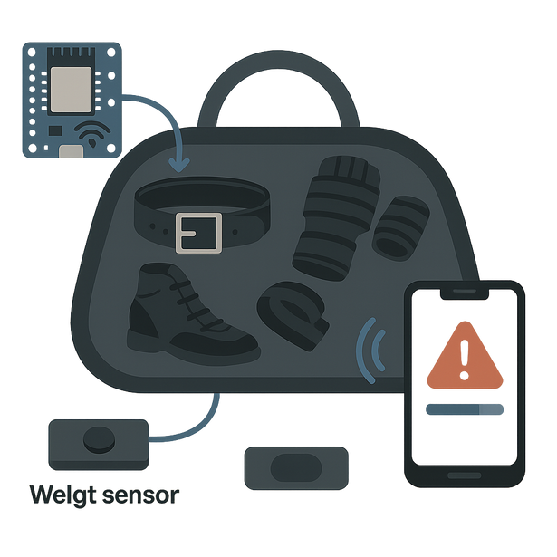
Aims & Objectives
The project aims to develop a smart gym bag for powerlifters that uses IoT to detect missing gear in real time and alert users instantly.
Objectives
Track gear using weight sensors + microcontroller
Create a mobile app to register gear and receive alerts
Notify users when any item is missing
5

Slide 6
Background
Powerlifters rely on essential gear for safety and performance, but traditional packing methods are unreliable—especially under pressure.
The ProGear Smart Bag solves this by using IoT technology to track missing items through weight sensors.
Load cells detect missing gear.
ESP32 processes data.
HX711 converts signals.
Bluetooth connects to a Flutter app for real-time alerts.
This system ensures athletes never forget key equipment again.
6

Slide 7
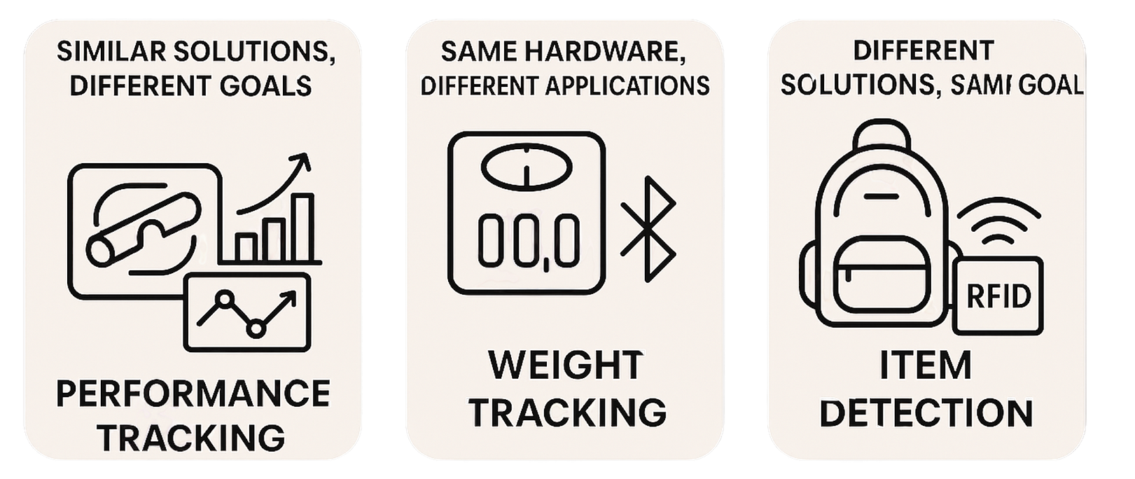
Related Work
7

Slide 8

Related Work
Many studies explored sensor and Bluetooth technologies for sports and health, but none directly addressed detecting missing gear inside gym bags.
Similar solutions, different goals:
Same hardware, different applications:
Different solutions, same goal:
Bousselmi et al. used load cells for performance tracking, not gear detection.
Hettiarachchi built an IoT gym tracker for body weight, not equipment management.
Robotique.tech used HX711 + ESP32 for health-focused weight tracking.
Nordic’s Gymplanner used BLE to monitor equipment usage, not what's inside bags.
Singh & Nigam used RFID to detect missing items in school bags.
Lenovo’s smart backpack included sensors but lacked weight-based tracking.
Smart lockers check gear presence but are not portable.
8

Slide 9

Requirement Elicitation Techniques
Technique we used :
We used questionnaires to collect requirements from potential users, specifically powerlifters.
Why this method?
Fast and easy to distribute.
Reached multiple users efficiently.
Gave us direct insight into common gear-related issues
Helped identify user needs and priorities
The feedback shaped key features like real-time alerts, weight tracking, and mobile app simplicity.
9

Slide 10
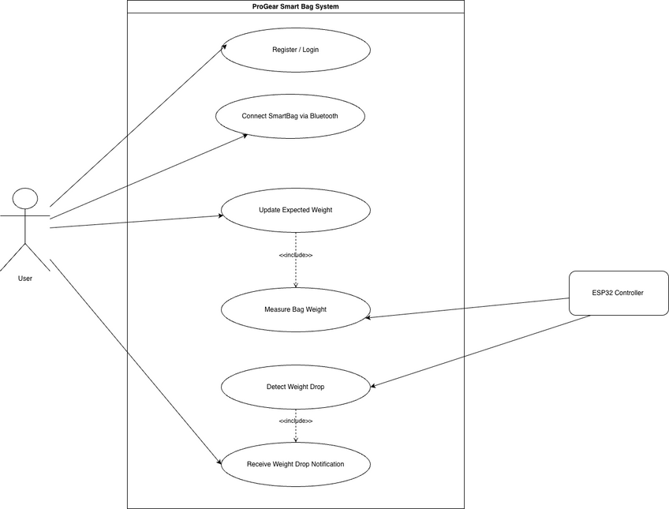
System Analysis & Design
This diagram shows how the user interacts with the ProGear Smart Bag system. It starts with registration and Bluetooth connection, then measures the bag's weight using the ESP32 controller. If a weight drop is detected, the user receives a real-time notification.
10

Slide 11
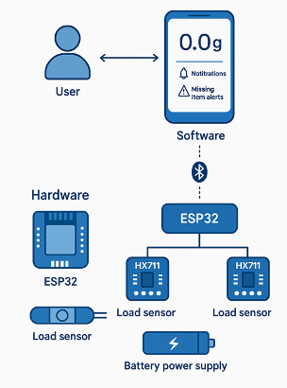
Architectural Design
The ProGear Smart Bag system consists of three main components. The user interacts with a mobile app that displays the gear status and sends alerts when an item is missing. The app communicates with the ESP32 controller via Bluetooth. The ESP32 receives weight data from load sensors through HX711 modules. Based on this data, it detects if any item is missing and sends real-time updates to the app.
11

Slide 12
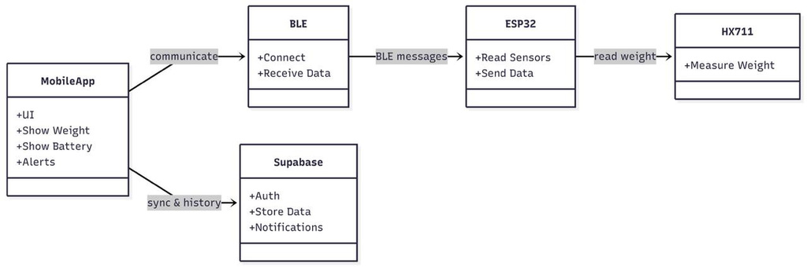
Class Diagram
This class diagram shows how the system works. The user logs in through the app. The ESP32 controller reads weights from sensors, compares them to expected values, and sends a notification if something is missing.
12

Slide 13
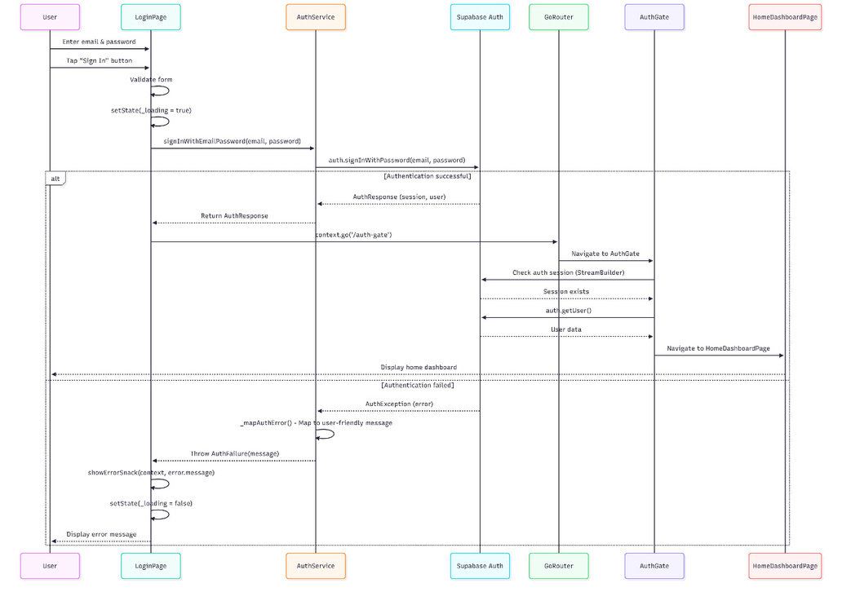
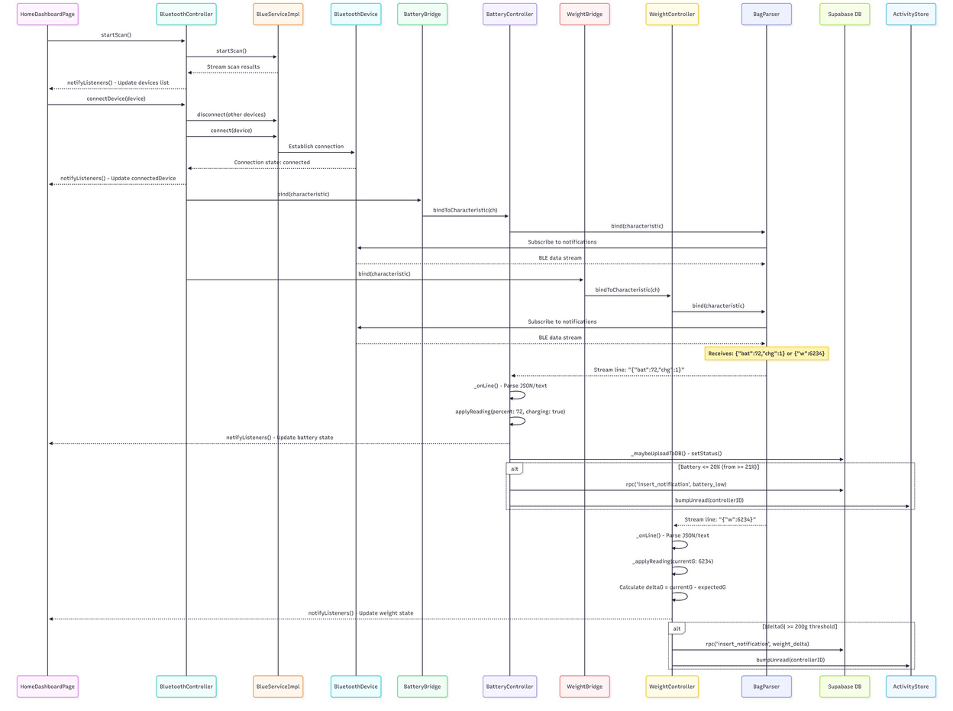
Sequence Diagram
Bluetooth Connection and Data Streaming Flow
User Login Flow
13

Slide 14
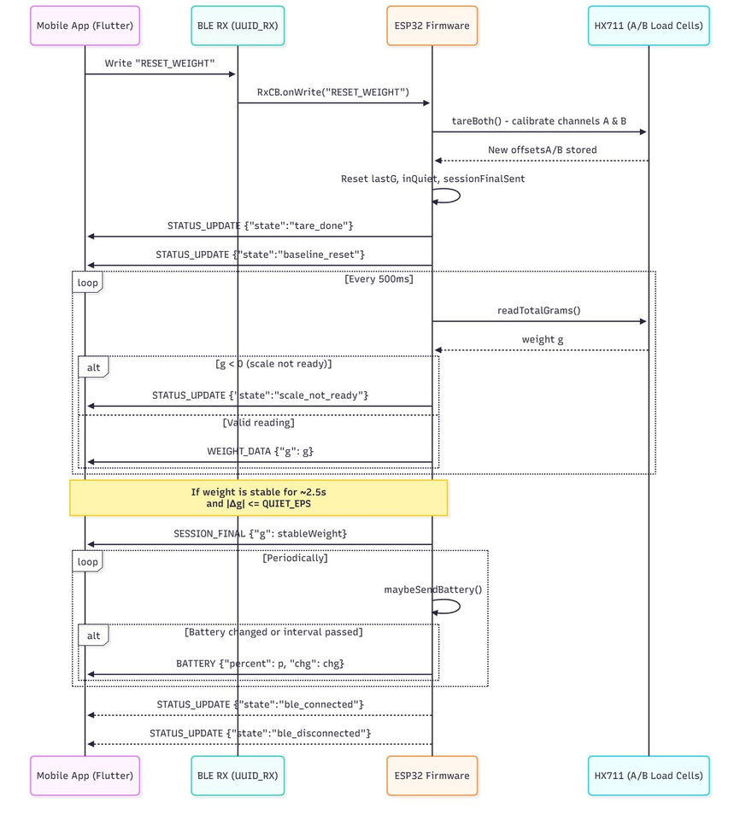
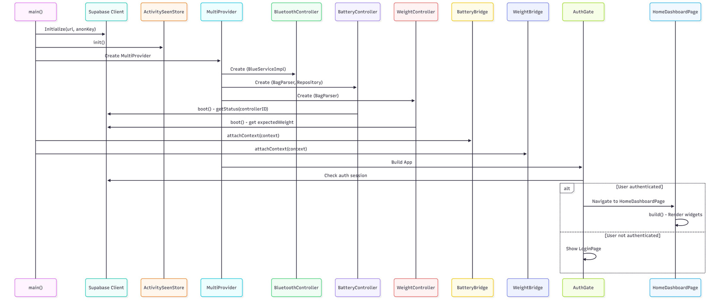
Sequence Diagram
App Initialization and Home Dashboard Flow
Hardware Weight & BLE Streaming Flow
14

Slide 15
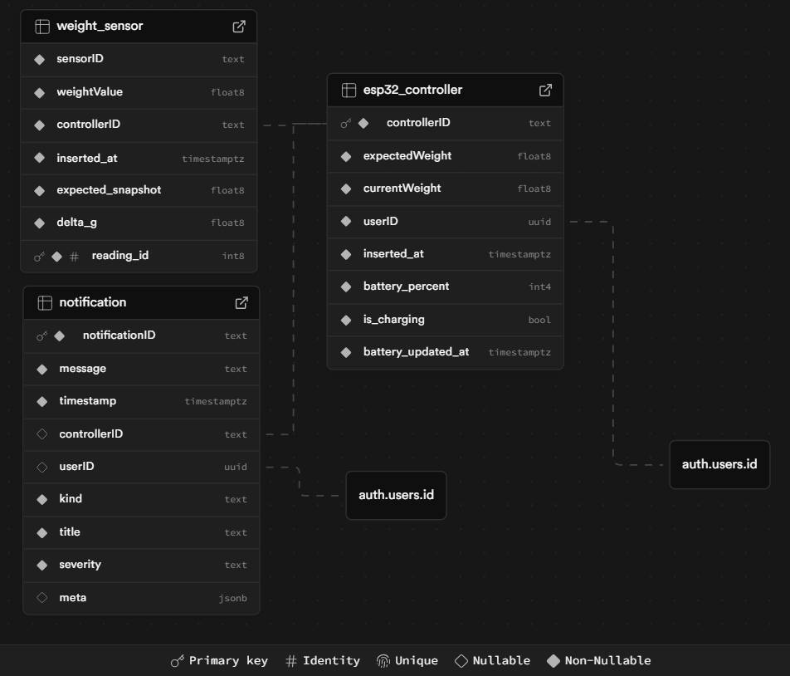
ER Diagram
shows how the main database tables in the ProGear system are connected. Each user is linked to one ESP32 controller, which connects to multiple weight sensors. Notifications are linked to both the user and controller, and store messages about missing items along with timestamps. This structure ensures accurate tracking of gear and clear user-alert history.
15

Slide 16





Implementation
Software Tools
The Implementation phase focused on building the hardware prototype, developing the Flutter mobile application, and integrating both through Bluetooth Low Energy (BLE). This stage transformed our system design into a fully functional prototype.
Supabase
Flutter
BLE
GitHub
Jira
Figma
16

Slide 17

Implementation
The hardware implementation of the ProGear Smart Bag was built using a set of lightweight and reliable electronic components. The ESP32 served as the main controller, handling sensor readings and BLE communication. Dual load-cell sensors, connected through HX711 amplifiers, were used to accurately measure the weight inside the bag. A rechargeable battery
the entire system, while breadboards, wiring, and connectors supported prototyping and stable assembly of the final circuit.
17

Slide 18
Unit Testing
Added a short initialization delay for the HX711 sensor.
Improved wiring and applied filtering to stabilize weight readings.
Enforced connection-first workflow so the dashboard displays accurate, real-time data.
Problems
Solutions
Delayed initialization of the HX711 sensor.
Unstable and noisy weight readings.
Dashboard loaded incorrect data if accessed before Bluetooth connection.
19

Slide 19
Integration Testing
Problems
Solutions
Restructured workflow: dashboard only accessible after BLE connection.
System automatically requests weight and battery data once connected.
Implemented weight-stability check to report final reliable readings.
Dashboard no longer loads dummy values at any stage.
Dashboard showed incorrect or zero/default values after Bluetooth pairing.
Weight and battery data did not update if dashboard opened before BLE connection.
Rapid item movements caused weight readings to fluctuate.
19

Slide 20
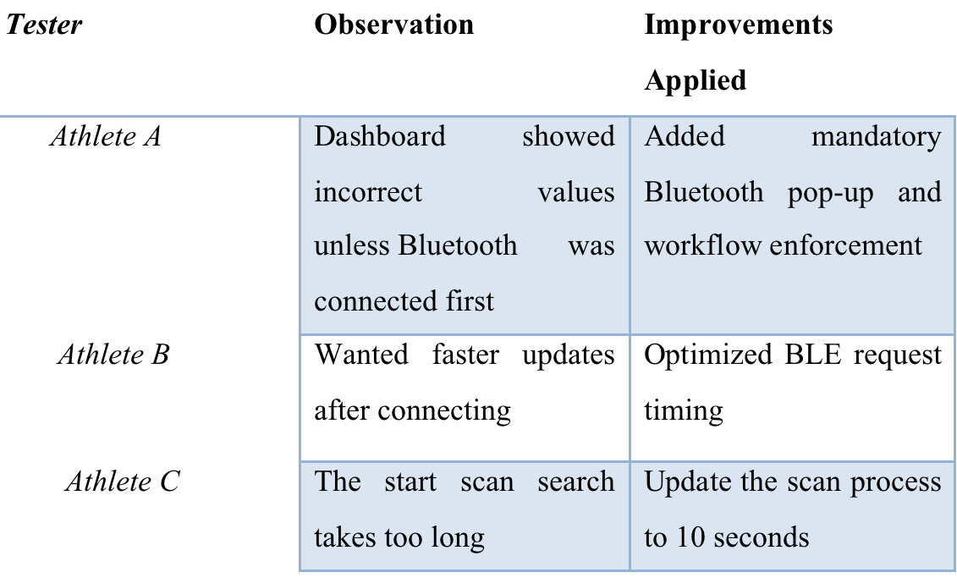
User Acceptance Testing
Tested by three athletes to evaluate accuracy and ease of use.
Scenarios: powering the bag, Bluetooth connection, live weight & battery monitoring, adding/removing items to check missing-item detection.
Minor issues (delays, pairing guidance) were resolved with workflow updates and prompts.
Outcome: Smooth operation, accurate real-time updates, user-friendly interface, fully ready for real-world use and future enhancements.
Feedback and Observations
18

Slide 21
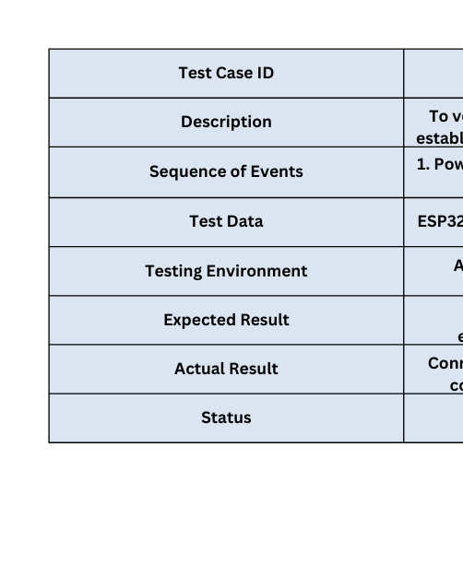
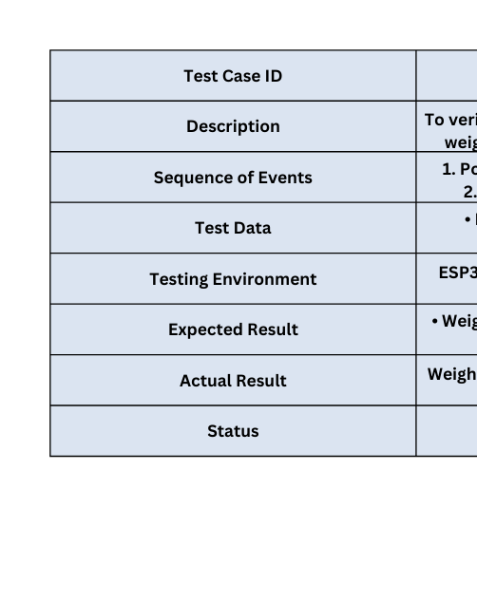
Test Cases
Test Case 2: Weight Measurement Accuracy
Test Case 1: Bluetooth connection
19

Slide 22
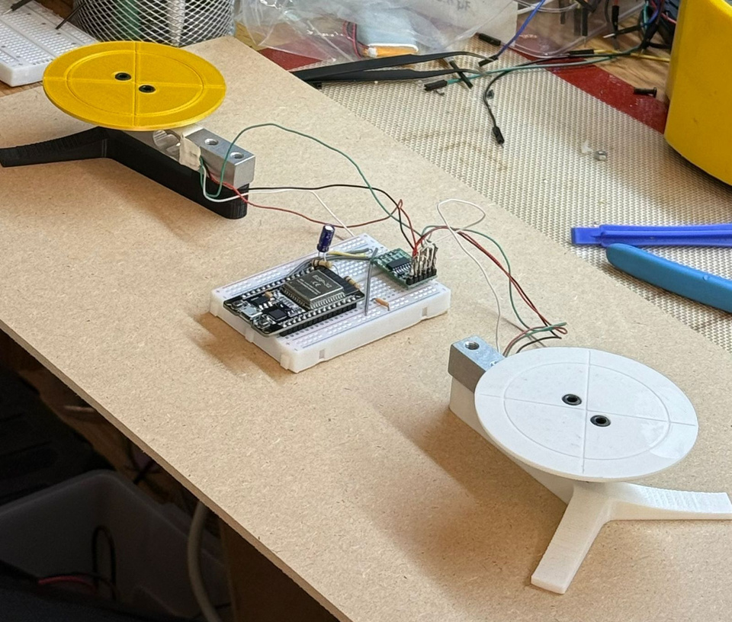
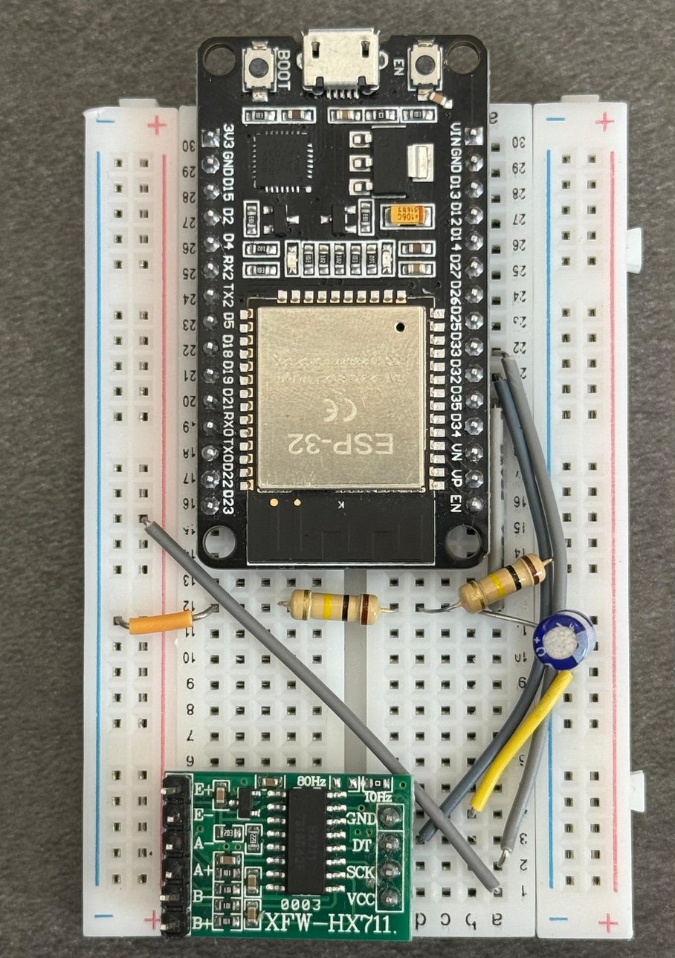
Hardware
20

Slide 23
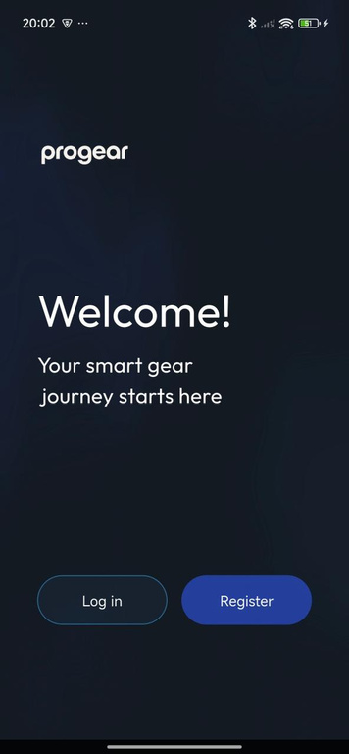
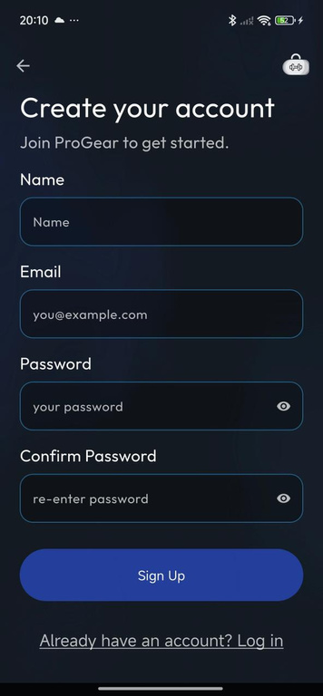
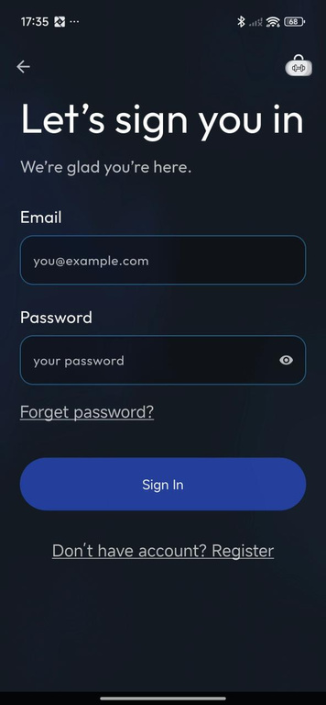
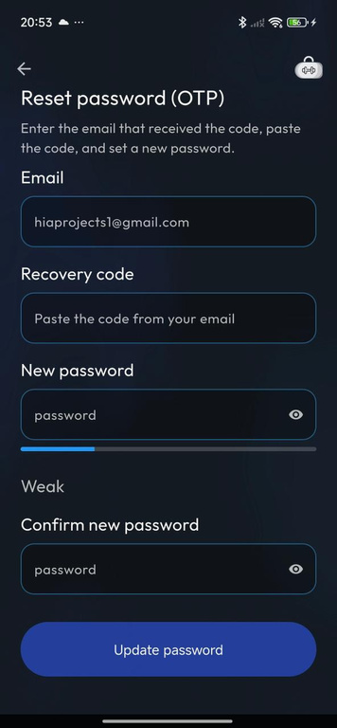
Mobile App Interfaces
21

Slide 24
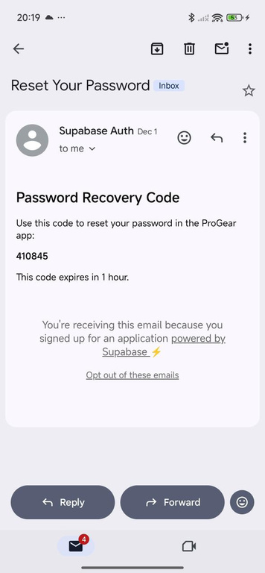
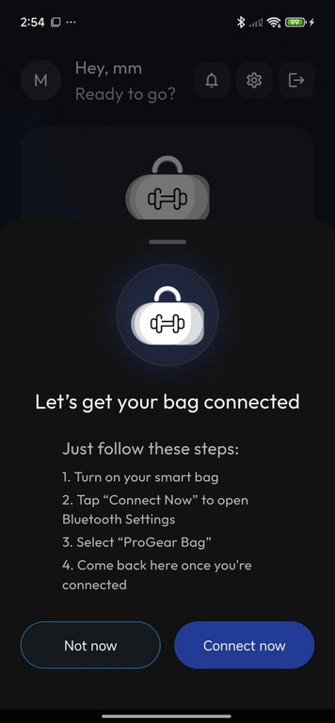
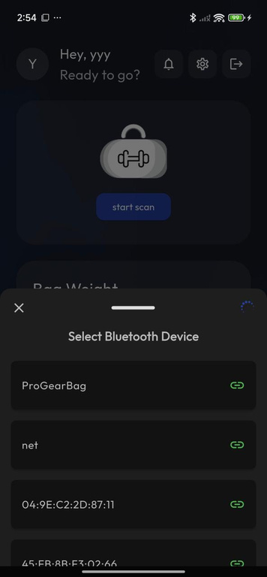
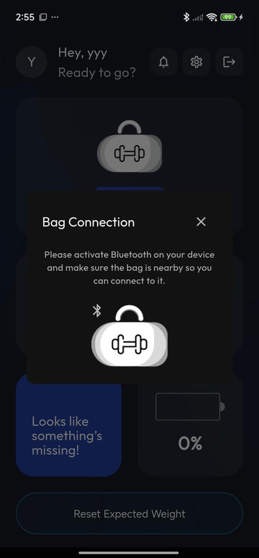
Mobile App Interfaces
21

Slide 25
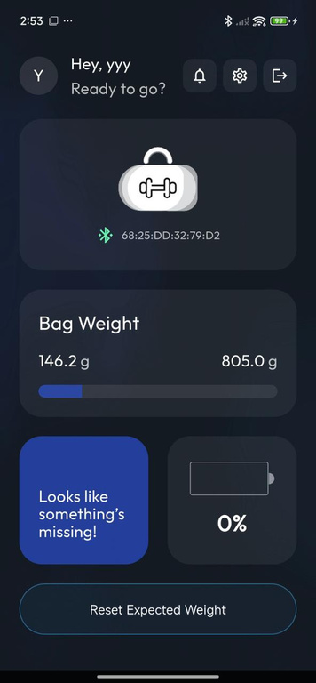
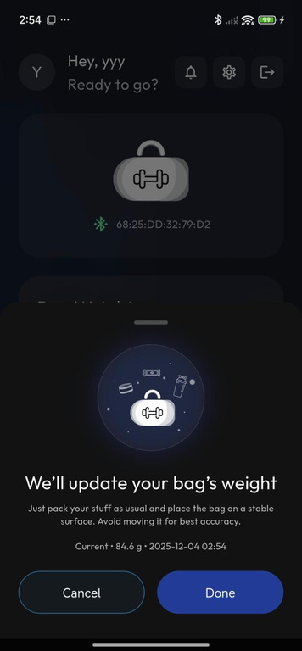
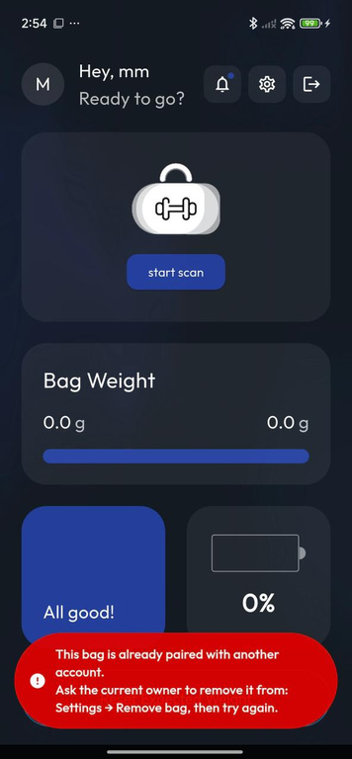
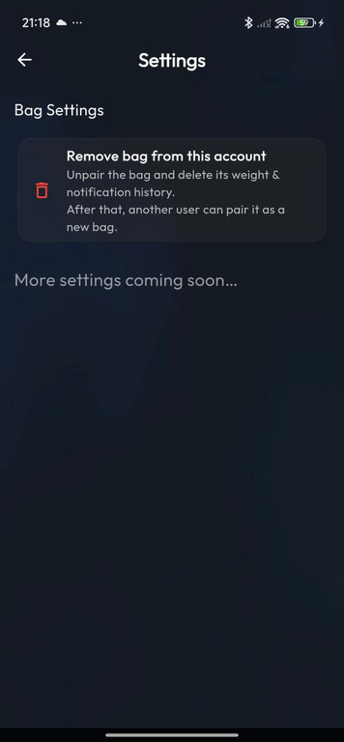
Mobile App Interfaces
21

Slide 26
Conclusion & Future Work
ProGear it’s more than just a smart bag; it's a step toward smarter, safer, and more focused training. By addressing a real problem with a practical and user-friendly approach, our project demonstrates how simple technology can make a meaningful impact in athletic preparation.
Future enhancements may include multi-sensor support, per-item identification using machine learning, adaptive thresholds, AI-based motion filtering, cloud integration for analytics, smarter notifications, and expanded mobile app features.
24

Slide 27


References

Slide 28
Thanks for listening !
Any Questions ?

